Slide 1
IE 340/440
PROCESS IMPROVEMENT
THROUGH PLANNED EXPERIMENTATION
Confidence Interval Estimation
Dr. Xueping Li
University of Tennessee

Slide 2

Chapter Topics
Estimation Process
Point Estimates
Interval Estimates
Confidence Interval Estimation for the Mean ( Known)
Determining Sample Size
Confidence Interval Estimation for the Mean ( Unknown)

Slide 3
Chapter Topics
(continued)
Confidence Interval Estimation for the Proportion
Confidence Interval Estimation for Population Total
Confidence Interval Estimation for Total Difference in the Population
Estimation and Sample Size Determination for Finite Population
Confidence Interval Estimation and Ethical Issues

Slide 4


Estimation Process
Population
Random Sample
I am 95% confident that μ is between 40 & 60.
Mean
X = 50
Mean, μ, is unknown
Sample

Slide 5

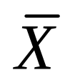

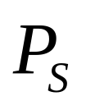
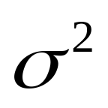
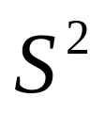
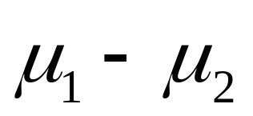
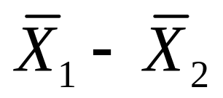
Point Estimates
Estimate Population
Parameters …
with Sample
Statistics
Mean
Proportion
Variance
Difference

Slide 6
Interval Estimates
Provide Range of Values
  Take into consideration variation in sample statistics from sample to sample
  Based on observation from 1 sample
  Give information about closeness to unknown population parameters
  Stated in terms of level of confidence
    Never 100% sure

Slide 7
Confidence Interval Estimates
Confidence
Intervals
Mean
Proportion
σ
Known
σ
Unknown

Slide 8


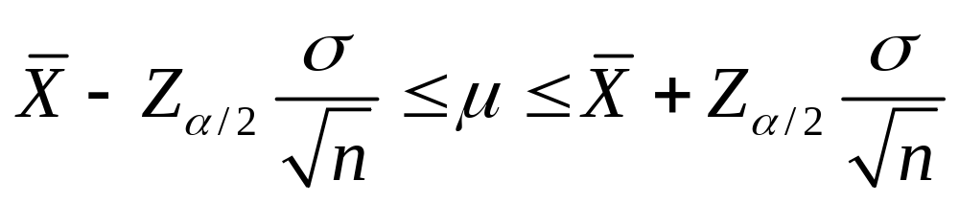
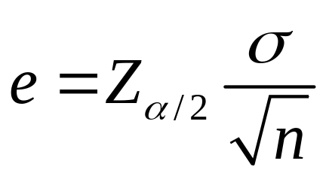
Confidence Interval for
( Known)
Critical Value
Assumptions
  Population standard deviation is known
  Population is normally distributed
  If population is not normal, use large sample
Confidence Interval Estimate
  is called the sampling error or margin of error
Standard Error

Slide 9
Elements of Confidence Interval Estimation
Level of Confidence
  Confidence that the interval will contain the unknown population parameter
Precision (Range)
  Closeness to the unknown parameter
Cost
  Cost required to obtain a sample of size n

Slide 10
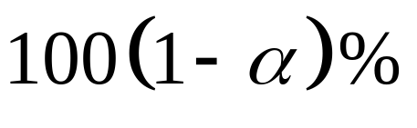
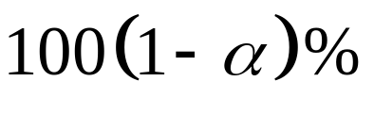
Level of Confidence
Denoted by
A Relative Frequency Interpretation
  In the long run, of all the confidence intervals that can be constructed will contain (bracket) the unknown parameter
A Specific Interval Will Either Contain or Not Contain the Parameter
  No probability involved in a specific interval

Slide 11
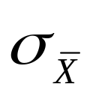
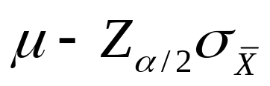

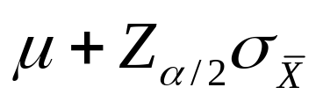
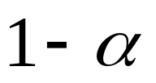
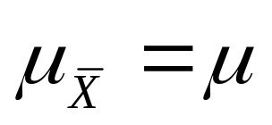
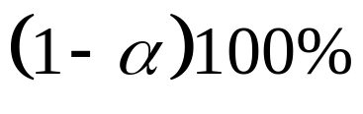
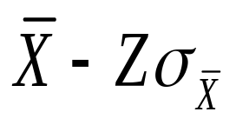
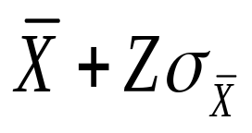


Interval and Level of Confidence
Sampling Distribution of the Mean
_
Intervals extend from
to
of intervals constructed contain ;
do not.
Confidence Intervals

Slide 12
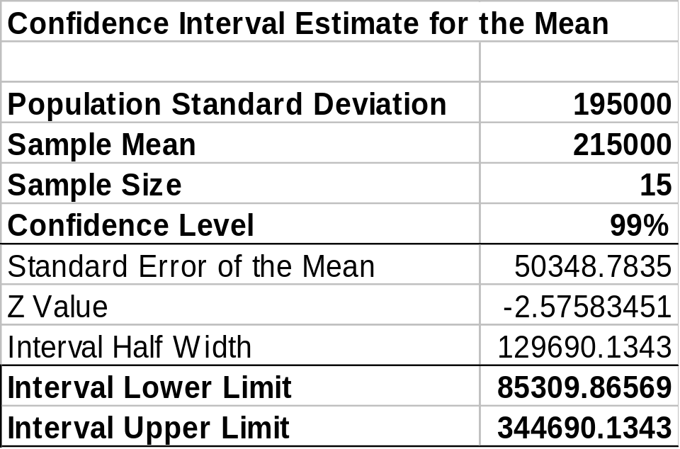

Example
PHStat output
A random sample of 15 stocks traded on the NASDAQ showed an average shares traded to be 215000. From past experience, it is believed that the population standard deviation of shares traded is 195000 and the shares traded are very close to a normal distribution. Construct a 99% confidence interval for the average shares traded on the NASDAQ. Interpret your result.
The 99% CI for the population mean:

Slide 13
Example: Interpretation
(continued)
If all possible samples of size 15 are taken and the corresponding 99% confidence intervals are constructed, 99% of the confidence intervals that are constructed will contain the true unknown population mean.
We are 99% confident that the population average number of shares traded on the NASDAQ is between 85309 and 344690.
For this particular confidence interval [85309, 344690], the unknown population mean can either be in the interval or not in the interval. It is, therefore, incorrect to state that the probability is 99% that the unknown population mean will be in the interval [85309, 344690].

Slide 14
Example: Interpretation
(continued)
Using the confidence interval method on repeated sampling, the probability that we will have constructed a confidence interval that will contain the unknown population mean is 99%.

Slide 15
Obtaining Confidence Interval in PHStat
PHStat | Confidence Interval | Estimates for the Mean, Sigma Known

Slide 16

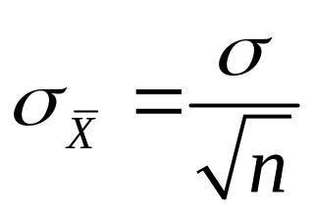
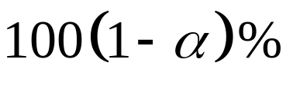
Factors Affecting Interval Width
(Precision)
Data Variation
  Measured by
Sample Size
Level of Confidence
Intervals Extend from
X - Zσ to X + Z σ
x
x
© 1984-1994 T/Maker Co.

Slide 17

Determining Sample Size (Cost)
Too Big:
Requires more resources
Too small:
Won’t do the job

Slide 18
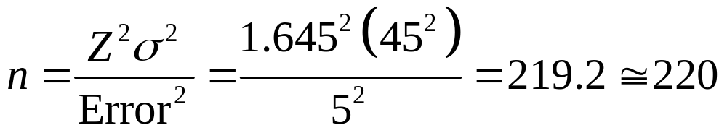
Determining Sample Size for Mean
What sample size is needed to be 90% confident of being correct within ± 5? A pilot study suggested that the standard deviation is 45.
Round Up

Slide 19
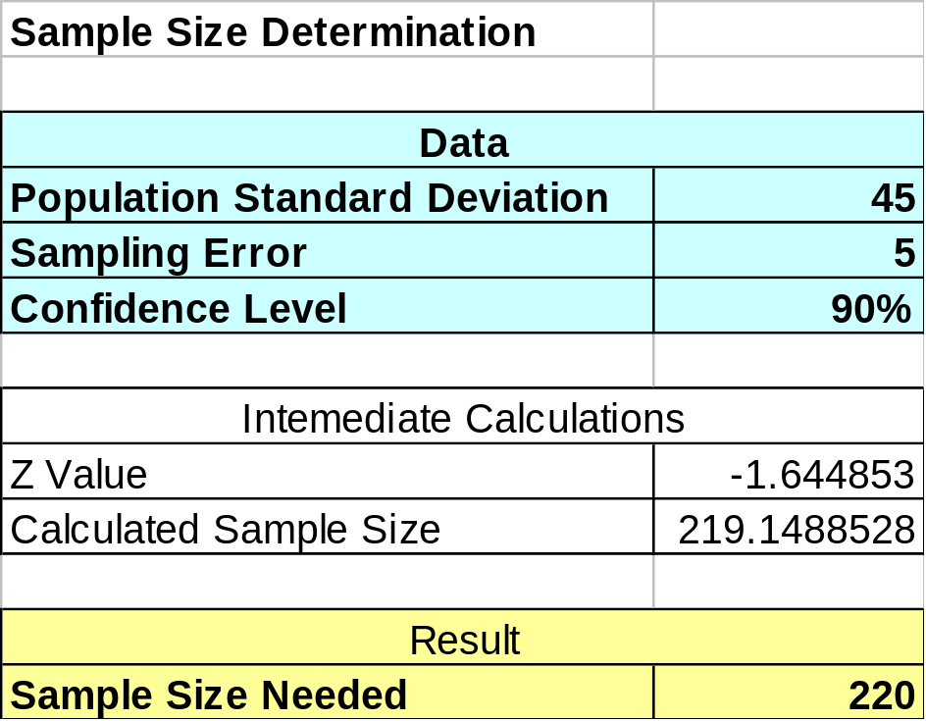

Determining Sample Size for Mean in PHStat
PHStat | Sample Size | Determination for the Mean …
Example in Excel Spreadsheet

Slide 20
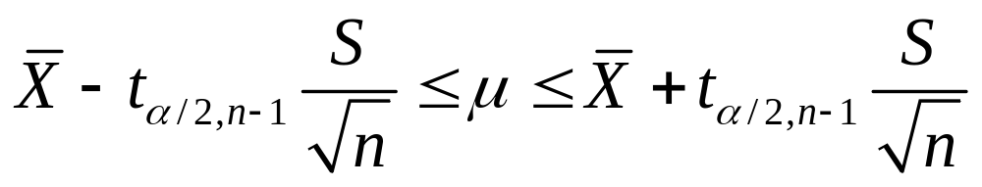
Confidence Interval for
( Unknown)
Standard Error
Assumptions
  Population standard deviation is unknown
  Population is normally distributed
  If population is not normal, use large sample
Use Student’s t Distribution
Confidence Interval Estimate
Margin of Error

Slide 21
Student’s t Distribution
Standard Normal
Bell-Shaped
Symmetric
‘Fatter’
Tails
t (df = 13)
t (df = 5)
Z
t
0

Slide 22
Student’s t Table
Let: n = 3
df = n - 1 = 2
α = .10
α/2 =.05
Upper Tail Area
df
.25
.10
.05
1
1.000
3.078
6.314
α / 2 = .05
2
0.817
1.886
2.920
3
0.765
1.638
2.353
0
t
2.920
t Values

Slide 23
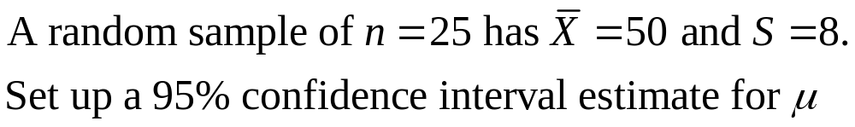
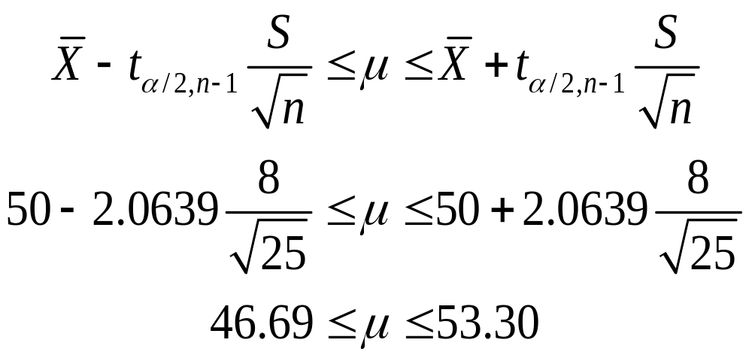
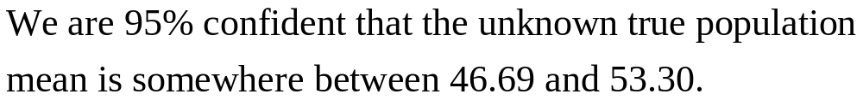
Example
.

Slide 24
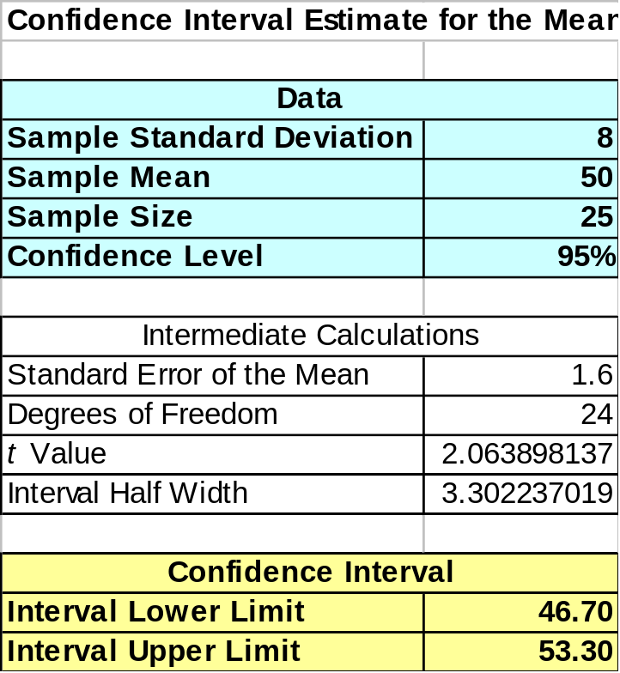
Confidence Interval for
( Unknown) in PHStat
PHStat | Confidence Interval | Estimate for the Mean, Sigma Unknown
Example in Excel Spreadsheet

Slide 25
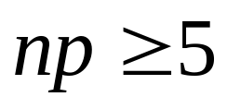
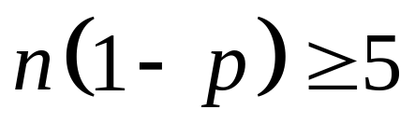
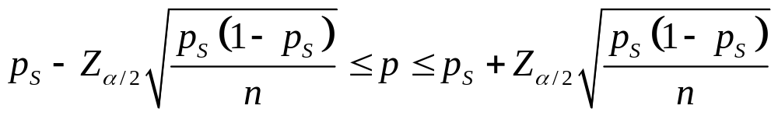
Confidence Interval Estimate for Proportion
Standard Error
Assumptions
  Two categorical outcomes
  Population follows binomial distribution
  Normal approximation can be used if
  and
  Confidence Interval Estimate
Margin of Error

Slide 26
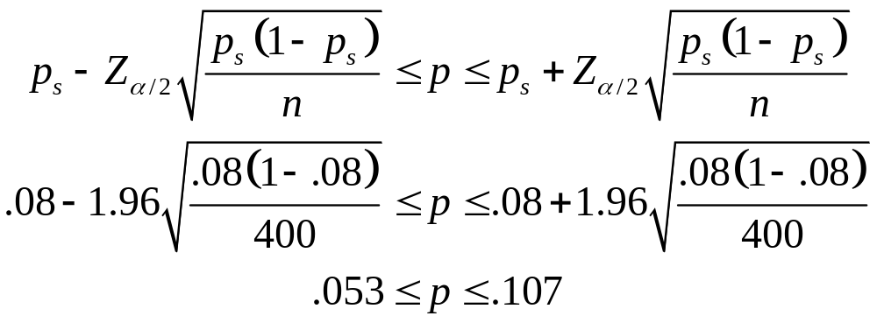
Example
A random sample of 400 voters showed that 32 preferred Candidate A. Set up a 95% confidence interval estimate for p.
We are 95% confident that the proportion of voters who prefer Candidate A is somewhere between 0.053 and 0.107.

Slide 27
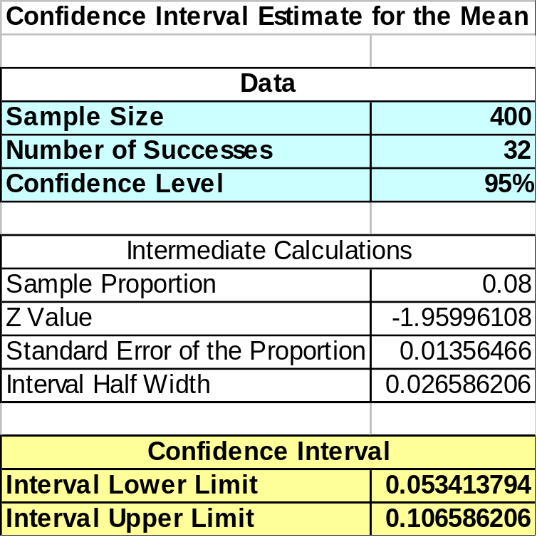
Confidence Interval Estimate for Proportion in PHStat
PHStat | Confidence Interval | Estimate for the Proportion …
Example in Excel Spreadsheet

Slide 28
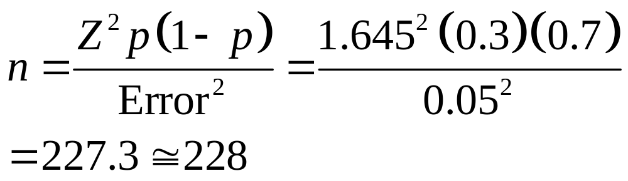
Determining Sample Size for Proportion
Out of a population of 1,000, we randomly selected 100, of which 30 were defective. What sample size is needed to be within ± 5% with 90% confidence?
Round Up

Slide 29

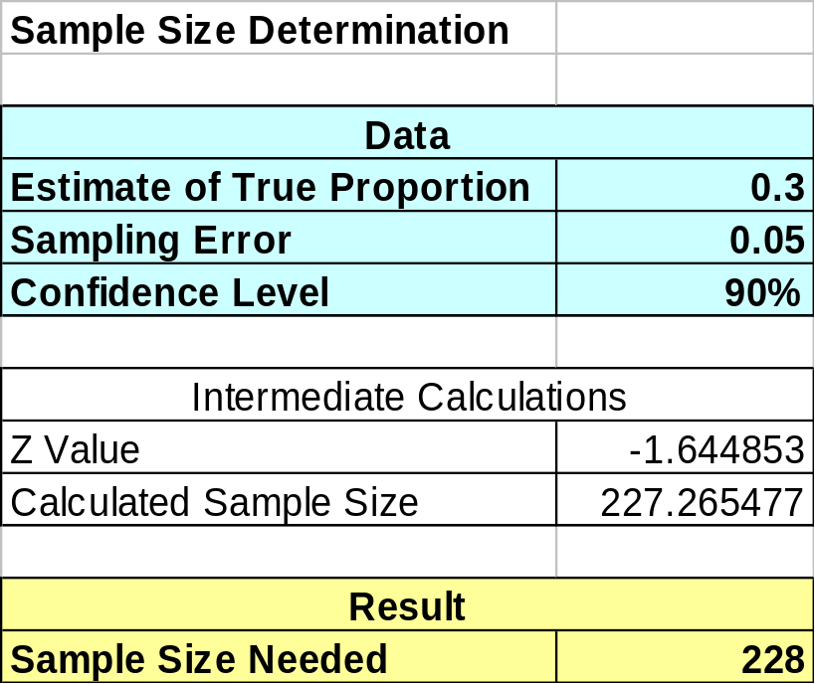
Determining Sample Size for Proportion in PHStat
PHStat | Sample Size | Determination for the Proportion …
Example in Excel Spreadsheet

Slide 30
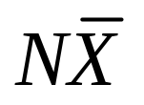
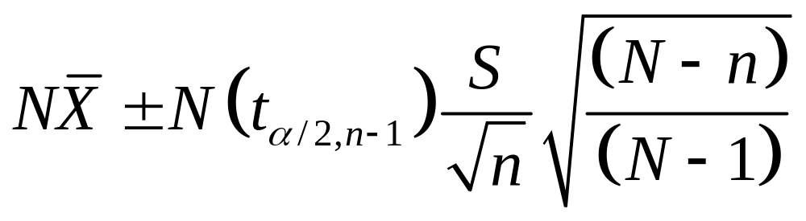
Confidence Interval for Population Total Amount
Point Estimate
Confidence Interval Estimate

Slide 31

Confidence Interval for Population Total: Example
An auditor is faced with a population of 1000 vouchers and wishes to estimate the total value of the population of vouchers. A sample of 50 vouchers is selected with the average voucher amount of $1076.39, standard deviation of $273.62. Set up the 95% confidence interval estimate of the total amount for the population of vouchers.

Slide 32
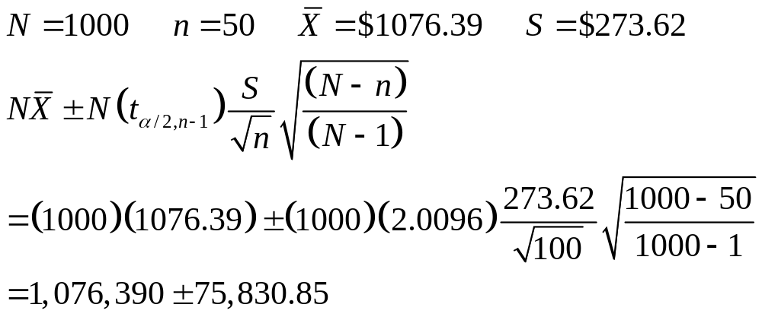
Example Solution
The 95% confidence interval for the population total amount of the vouchers is between 1,000,559.15 and 1,152,220.85.

Slide 33

Example Solution in PHStat
PHStat | Confidence Intervals | Estimate for the Population Total
Excel Spreadsheet for the Voucher Example

Slide 34
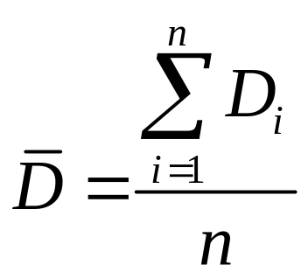
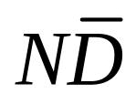
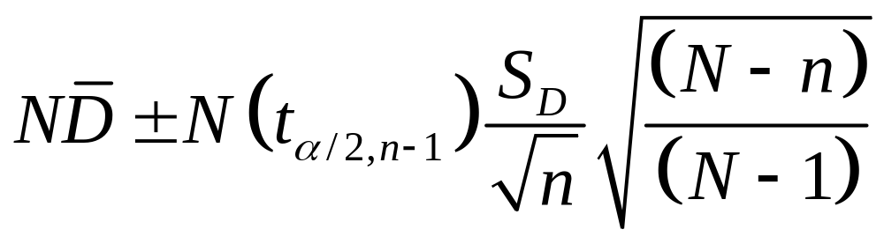
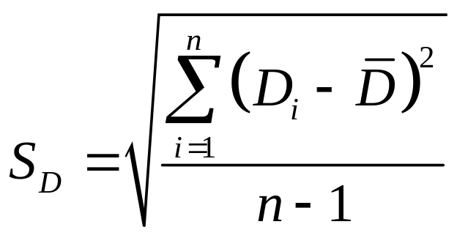
Confidence Interval for Total Difference in the Population
Point Estimate
  where is the sample average difference
Confidence Interval Estimate
  where

Slide 35

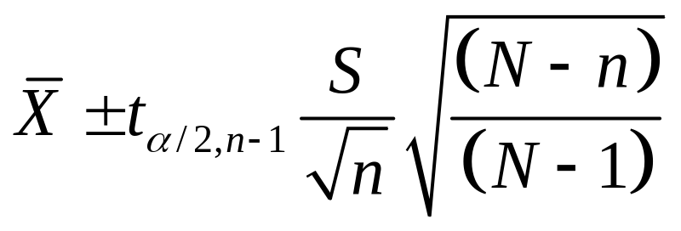
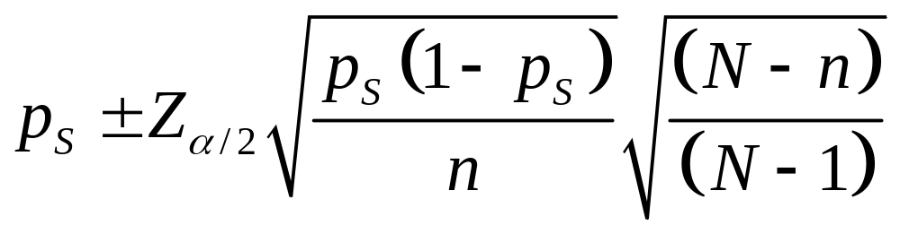
Estimation for Finite Population
Samples are Selected Without Replacement
  Confidence interval for the mean ( unknown)
  Confidence interval for proportion

Slide 36
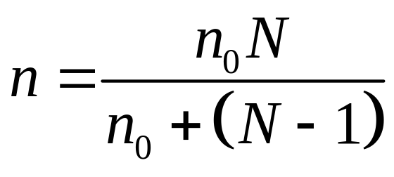
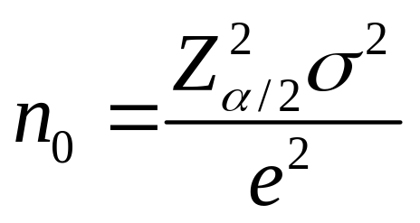
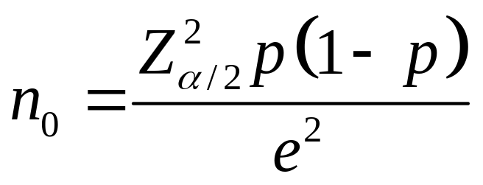
Sample Size (n ) Determination for Finite Population
Samples are Selected Without Replacement
  When estimating the mean
  When estimating the proportion

Slide 37
Ethical Issues
Confidence Interval (Reflects Sampling Error) Should Always Be Reported Along with the Point Estimate
The Level of Confidence Should Always Be Reported
The Sample Size Should Be Reported
An Interpretation of the Confidence Interval Estimate Should Also Be Provided

Slide 38
Chapter Summary
Illustrated Estimation Process
Discussed Point Estimates
Addressed Interval Estimates
Discussed Confidence Interval Estimation for the Mean ( Known)
Addressed Determining Sample Size
Discussed Confidence Interval Estimation for the Mean ( Unknown)

Slide 39
Chapter Summary
(continued)
Discussed Confidence Interval Estimation for the Proportion
Addressed Confidence Interval Estimation for Population Total
Discussed Confidence Interval Estimation for Total Difference in the Population
Addressed Estimation and Sample Size Determination for Finite Population
Addressed Confidence Interval Estimation and Ethical Issues

